Slide 1
Probability and Statistical Inference
Multiple Linear Regression
Sources used in creation of this lecture:
Statistics and Data Analysis, Peck, Olsen and Devore; Discovering Statistics Using IBM SPSS, Andy Field; Understanding Basic Statistics, Brase and Brase;SPSS Survival Manual, Julie Pallant

Slide 2
What is Linear Regression?
It is a hypothetical model of the relationship between two variables.
The model used is a linear one.
Theoretical assumption
For every one unit of change in the independent variable there will be a consistent and uniform change in the dependent variable
Therefore, we describe the relationship using the equation of a straight line.
This can be seen as a way of predicting the value of one variable from another.

Slide 3
Before Regression
We need to establish evidence to support going ahead with building a predictive model
If we are asserting a relationship
We need to investigate if there is any evidence of a relationship using the appropriate test and make a decision based on the results (strength, direction etc.)
If we are asserting a differential effect for different groups
We need to investigate if there is any difference using the appropriate test and make a decision based on the result

Slide 4
Regression – what does it allow you do?
Questions it allows you to answer:
How well a set of variables is able to predict an outcome variable
Which variable in a set is the best predictor
Whether a variable is still able to predict an outcome when controlling for a particular variables
Prediction
Really what we are looking at is the variance in the outcome variable and how much of the variance could be considered to be explained by the predictor variables

Slide 5
Before Regression
We need to establish evidence to support going ahead with building a predictive model
If we are asserting a relationship
We need to investigate if there is any evidence of a relationship using correlation and make a decision based on the results (strength, direction etc)
If we are asserting a differential effect for different groups
We need to investigate if there is any difference using either the appropriate test and make a decision based on the result

Slide 6
Parametric v Non-Parametric Tests
Testing For | Parametic | Non-Parametric
Correlation | Pearson | Spearman/Kendall
Comparing Groups - 2 independent samples scale data | Independent t-test | Mann Witney U
Comparing Groups - 2 related (paired) samples scale data | Paired Samples t-test | Wilcoxon Signed Rank
Comparing Groups - 2 independent samples categorical data |  | Chi-Square
Comparing Groups - repeated measures categorical data |  | McNemar's
Comparing Groups - more than 2 independent samples | One Way ANOVA | Kruskal Wallis

Slide 7
Simple Linear Regression
Four important statistics
F statistic
Whether the model as a whole predicts the dependent variable
Its statistical significance is the significance of the model
Regression coefficients (Beta values)
Measure the strength and direction of relationships between independent variables and the dependent variance
Significance scores for the regression coefficients
Tell us whether the contribution of each variable is statistically significant
R² statistic or Adjusted R² Statistic
Measures the model’s overall predictive power and the extent to which the variables explain the variation found in the dependent variable

Slide 8
How to Interpret Beta Values
Beta values:
the change in the outcome associated with a unit change in the predictor.
Standardised beta values:
tell us the same but expressed as standard deviations.
If we have standardised our variables in advance this will be virtually the same.

Slide 9
R² V Adjusted R²
Every time you add a predictor to a model, the R-squared increases, even if due to chance alone. It never decreases.
Therefore, a model with more terms may appear to have a better fit simply because it has more terms.
If a model has too many predictors it begins to model the random noise in the data.
This condition is known as overfitting the model and it produces misleadingly high R-squared values and a lessened ability to make predictions.
Adjusted R²
Adjusts value of R² based on number of variables in the model
Report Adjusted R² for multiple linear regression

Slide 10
What is Multiple Regression?
Simple linear Regression is a model to predict the value of one variable from another.
Multiple Regression is a natural extension of this model:
We use it to predict values of an outcome from several predictors.
It is a hypothetical model of the relationship between several variables.

Slide 11
Multiple Regression as an Equation
With multiple regression the relationship is described using a variation of the equation of a straight line.
b0 is the intercept.
The intercept is the value of the Y variable when all Xs = 0.
This is the point at which the regression plane crosses the Y-axis (vertical).
b1 to bn are the regression coefficient for variable 1 to n
Notes:
A similar equation can be derived in which each predictor variable has its own coefficient, and the outcome variable is predicted from a combination of all the variables multiplied by their respective coefficients plus a residual term (see equation above).
Y is the outcome variable, β₁ is the coefficient of the first predictor (X₁), β₂ is the coefficient of the second predictor (X₂), β_{n} is the coefficient of the n^{th} predictor (X_{n}), and ε_{i} is the difference between the predicted and the observed value of Y for the i^{th} subject. In this case, the model fitted is more complicated, but the basic principle is the same as simple regression. That is, we seek to find the linear combination of predictors that correlate maximally with the outcome variable.

Slide 12
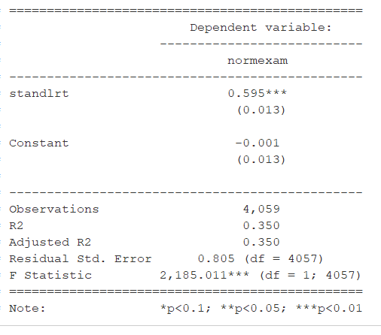
Conducting Linear Regression
Use lm to create our model and assign it to a variable
model1 = lm(regression$normexam~regression$standlrt)
stargazer(model1, type="text") #Tidy output of all the required stats

Slide 13
Dummy variables
Many variables we are interested in using as predictors are categorical
E.g. we are interested in the effect gender or religion or income category has
Because they have no scale it makes no sense to think of the effect of a unit of increase in these as it would for a continuous variable
But we can think in terms of the differential effect for groupings within the category
We can transform the categorical variable into a series of dummy variables which indicate whether a particular case has that particular characteristic
Dummy variables may also be referred to as indicator variables

Slide 14
Our regression dataset (Regression.sav)
Previously looked at standlrt as a predictor of normexam
We might also be interested in gender and whether it has an influence
There is significant research that gender has an influence in educational achievement.
We might also be interested in exploring the type of school a student attends (either mixed-sex or single-sex boys or girls schools) as this might also have an effect on a student’s examination performance (‘normexam’).
We are interested in exploring if there is a differential effect for students of different genders and for students of different genders attending different types of school.

Slide 15
Dummy Variables
If we just added them into the model as they are what would happen?
The values of these two variables would be treated as real numerical values rather than just arbitrary numbers representing specific categories.
So we need to transform these into dummy variables before we can add them into the regression model.

Slide 16
Dummy variables
Recode to 0 (reference category) and 1 (category of interest)
Aim is to explore if there is a differential effect for the category of interest when compared to the reference category
Indicator variable
Switch effect ON (1) or OFF (0)
Before including in the regression model need to first establish if this makes sense to include as a predictor
Investigate using an independent t-test.

Slide 17
Recoding Variables
library(car)
regression$gender=recode(regression$GIRL,'0=1;1=2')
(this creates a variable gender which recodes GIRL, if 0 gender is set to 1 and if 1 gender is set to 2)
* This assumes that you have called your dataset regression
* This is already done in the dataset the dataset regression we are using

Slide 18
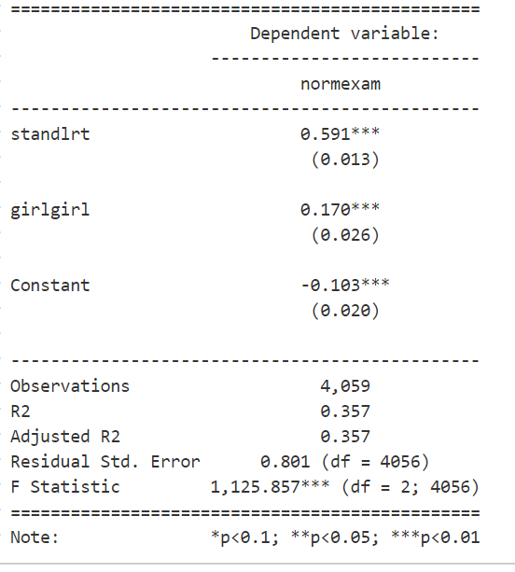
Second Model including gender
model2<-lm(regression$normexam~regression$standlrt+regression$girl)
stargazer(model2, type="text") #Tidy output of all the required stats
Variable girl – value girl

Slide 19
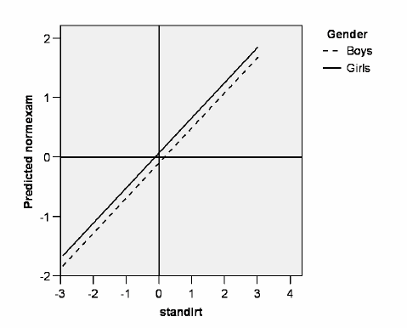
Example
In effect the consequence of adding the dummy variable ‘girl’ to the model is to create two lines of best fit that have the same gradient (0.591) but different intercepts (constants) (i.e. -0.103 for boys and 0.067 for girls).
In other words, and as illustrated below, this model can be represented as two parallel lines with the vertical distance between both lines being 0.170:

Slide 20
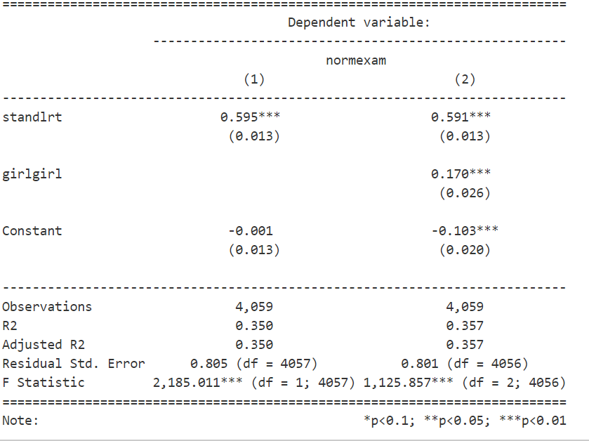
Comparison of models

Slide 21
Example
This model is fine but it does assume that the gap in exam scores at age 16 between boys and girls remains constant (at 0.170 points) regardless of a student’s prior educational achievement at 11 (‘standlrt’).
But it may be that high achieving boys at age 11 could be outperforming girls at age 16 and/or that low performing boys at age 11 may fall even further behind their female counterparts by the age of 16?
We are hypothesising here, in effect, that the gradients of both these lines of best fit might not be the same and thus these two lines might not actually be parallel
So to really improve this we would need to look at including an interaction term

Slide 22
Interaction term
We can test this hypothesis by adding what is referred to as an ‘interaction term’ to the model that is basically a new variable calculated by multiplying ‘standlrt’ by ‘girl’.
First, therefore, we need to create a new variable (which we can call ‘standlrt_girl’)
regression$interaction <- regression$standlrt * as.numeric(regression$girl)
*Already in our dataset

Slide 23
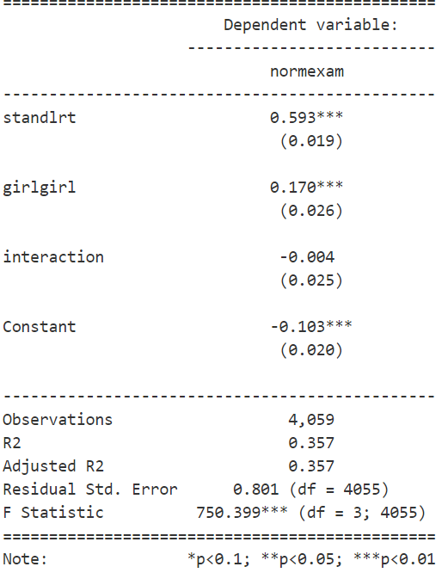
Model 3 – including an interaction term
Predicted normexam=-.103+0.593*standlrt+0.17*girl-0.0*interaction
Boys normexam=-.103+0.593=0.49
Girls normexam=-.103+(0.593-0.004) standlrt+.17= -.103+.589*standrt+.17
Conclusion that there is no real difference for low/high performing students of different gender.

Slide 24
Interaction term
We can see how the inclusion of the interaction term has basically had the consequence of giving us two lines of best fit (one for boys and one for girls) that now having differing intercepts as well as differing gradients or slopes.
On this occasion we already knew that the difference in the slopes was minor (and not statistically significant) and this is confirmed by these two lines of best fit where the difference in the gradients of both lines (0.593 compared to 0.589) is marginal and wouldn’t even be obvious to the eye if the two lines were plotted on a graph.
We would conclude that this interaction term has no significant effect on the model.

Slide 25
Dummy variables with more than two categories
We need to create a number of dummy coded variables (the number of which will be one less than the number of categories in the original variable).
We need to define one of the categories as the reference category.
Which category you pick is entirely up to you but it should make sense in the context of your question
For ordinal variables, it is usually best to select the lowest-ranked category as the reference category.

Slide 26
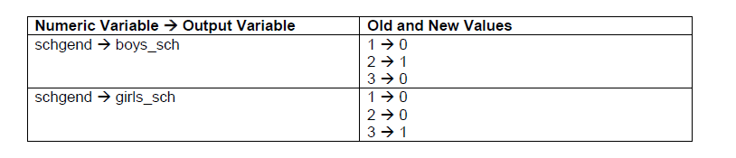
Dummy Variables
regression$boy_sch = ifelse(regression$schgend=="boysch", 1, 0)
regression$girl_sch = ifelse(regression$schgend=="girlsch", 1, 0)
This has already been done in the regression dataset we are using.
It is always worth just checking that you have recoded things properly by comparing the old and new variables via simple crosstabs

Slide 27
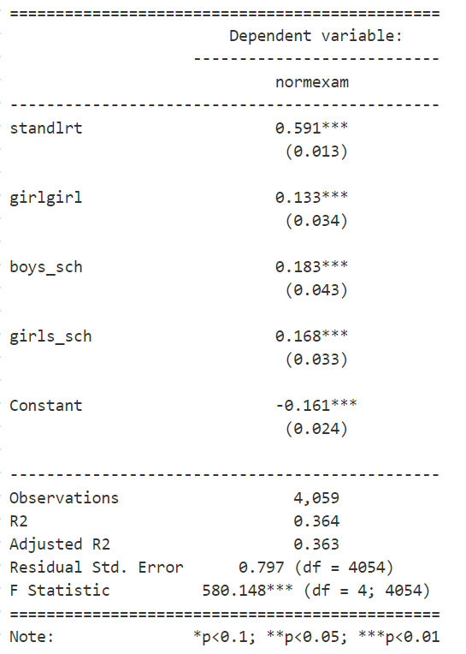
Model 4 – including school gender
model3<-lm(regression$normexam~regression$standlrt+regression$girl+regression$boys_sch+regression$girls_sch)
Stargazer(model3, type="text")

Slide 28
Interpreting the model
Predicted normexam=-.16+.59*standlrt+0.13*girl+0.18*boy_sch+0.17*girl_sch
 | Constant | Standlrt | Girl | Boy_sch | Girl_sch
Boy attending Boys only | -.16 | .59 | 0 | .18 | 0 | 0.61
Boy attending mixed school | -.16 | .59 | 0 | 0 | 0 | 0.43
Girl attending girls only | -.16 | .59 | .13 | 0 | .17 | 0.73
Girl attending mixed school | -.16 | .59 | .13 | 0 | 0 | 0.56

Slide 29
Model 4
So we can see a difference in scores for boys attending boys only and girls attending girls only

Slide 30
Reflecting on Regression

Slide 31
R and R2
R
The correlation between the observed values of the outcome, and the values predicted by the model.
R2
The proportion of variance accounted for by the model.
Adj. R2
An estimate of R2 in the population (shrinkage).

Slide 32
Analysis of Variance: ANOVA
The F-test
looks at whether the variance explained by the model is better than one with no predictors
It tells us whether using the regression model is significantly better at predicting values of the outcome than using the mean.

Slide 33
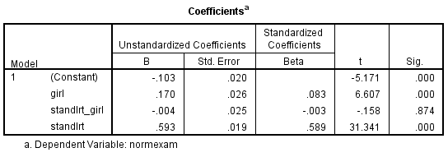
Output: betas
Beta values:
the change in the outcome associated with a unit change in the predictor.
Standardised beta values:
tell us the same but expressed as standard deviations.

Slide 34
Concerns for MLR - Choosing variables for MLR
Have a sound theoretical basis for including your variables
Explore the data using univariate and bivariate analysis
Only include variables that have potentially informative results or which serve as controls
In large models
Introduce variables sequentially
Start by introducing small groups
As you include more variables note no only how they operate but how the scores for other variables and their statistical significance change as well
If the model is statistically stable, these will stay within the same general range
If the values start changing a lot, it suggests you need to conduct some further exploratory work before trusting your findings

Slide 35
Concerns for MLR - Degrees of Freedom
The number of observations ‘free to vary’ in a sample
Every observation increases the df by one
But every coefficient the model estimates decreases it by one
Thus the more variables included in the model the more the df lowers which reduces the tests ability to find a statistically significant result
Why would this be a problem?
Reduces our statistical power
Increase possibility of Type II error

Slide 36
Residuals
Coefficients and statistical significance are calculated on the assumption that a straight line is a good model of the relationship
How well this line serves as a model of this relationship can be checked by looking at how well the observed data sit in relation to predicted values along this line
Measured by the vertical distance from the prediction to the actual observation – the residual
Regression coefficients are calculated so that the resulting line has the lowest possible accumulation of residuals, minimising the overall distance between the observation and the predictions

Slide 37
Regression Diagnostics
Methods for determining whether a regression model fit to data adequately represents the data.
Unusual data in linear models
Non-normality
Non-constant error variance
Nonlinearity in linear models

Slide 38
Some Terms
Outliers:
An observation that has a large residual i.e. the observed value for the point is very different from that predicted by the regression model.
Leverage points
An observation that has a value of x that is far away from the mean of x.
Influential observations
An observation that changes the slope of the line.
They have a large influence on the fit of the model.

Slide 39
Concerns for MLR – Outliers (residuals)
MLR can be greatly influenced by outliers
They ‘pull’ the equation away from the general pattern
Sometimes it is reasonable to delete the outliers
Sometimes you need to retain the outlier
it may be your most important observation
Sometimes it is a good idea to do your analysis twice – once with and once without the outlier to see how much influence it is having on the model
If you remove outliers, do repeat this residual analysis again, you may have introduced new outliers
Why would this be a problem?
Bias
Increased possibility of Type I error

Slide 40
Concerns for MLR - Outliers
Look at the Minimum and Maximum values of Std. Residual (Standardised Residual) subheading.
We would expect 95% to fall within +1.96 and -1.96 if our p value cut-off is 0.05 (5%).
If the minimum value is equal or below -3.29, or the maximum value is equal or above 3.29 (and out dataset has more than 80 cases) then you have outliers.
Cook’s distance
Measures the effect of deleting a case
Look at Cook’s distance for values greater than one
Should also graphically inspect relevant plots
Why would this be a problem?
Bias
Increased possibility of Type I error

Slide 41
Concerns for MLR – Constant variation
Sometimes the regression line is not well suited to the data
E.g. we may get a fan effect indicating that the regression line is better at predicting low values of the dependent variable than it is at predicting high values (or vice versa)
It is not appropriate therefore to use MLR in these cases even if there is strong coefficients and statistical significance
In a well-fitting regression model the variation around the line is constant along the line
Why would this be a problem?
Bias
Increased possibility of Type I error

Slide 42
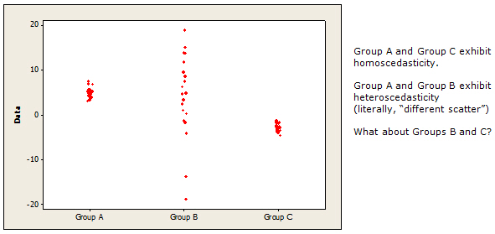
Homoscedasticity
Having the same scatter
Having data values that are scattered, or spread out, to about the same extent.
Why are we concerned?
Bias
Increased possibility of Type I error if heteroscedasticity

Slide 43
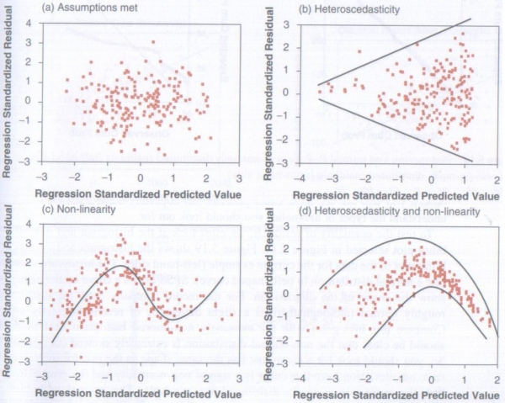
Homoscedasticity: ZRESID vs. ZPRED
From Andy Field:
You are looking for a plot like the top left

Slide 44
Concerns for MLR – Normality of residuals
Should follow a normal distribution with a mean of 0
Since the residuals measure where the points fall in relation to the regression line, a normal distribution of residuals indicates that the same number of points fall above and below the line
A residual of 0 means a point is on the line, a mean of 0 means that the line is in the middle of the points
The bell shape means that most are close to the line and there are fewer father from it
Why would this be a problem?
Bias
Increased possibility of Type I error

Slide 45
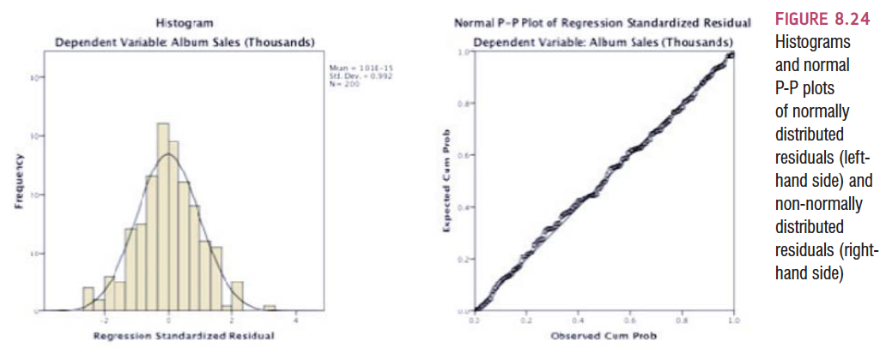
Normality of Errors: Histograms and P-P plots

Slide 46
Concerns for MLR - Collinearity
Occurs when two or more independent variables contain strongly redundant information
If variables are collinear then it means there is not enough distinct information in these variables for MLR to operate – they are essentially measuring the same thing
If we conduct MLR with collinear variables then the model will produce invalid results
Need to check for collinearity by examining a correlation matrix that compares your independent variables with each other.
A correlation coefficient above 0.8 suggests collinearity might be present
If it is you need to analyse your variables in separate regression equations and then examine how they operate together

Slide 47
Concerns for MLR - Collinearity
Occurs when two or more independent variables contain strongly redundant information
If variables are collinear then it means there is not enough distinct information in these variables for MLR to operate – they are essentially measuring the same thing
If we conduct MLR with collinear variables then the model will produce invalid results
Need to check for collinearity by examining a correlation matrix that compares your independent variables with each other.
A correlation coefficient above 0.8 suggests collinearity might be present
If it is you need to analyse your variables in separate regression equations and then examine how they operate together
Why would this be a problem?
Bias
Increased possibility of Type I error

Slide 48
Collinearity
What can we do?
Delete all but one of the collinear variables from the model
The one remaining is a proxy for the underlying concept
Combine them into an index mathematically (e.g. multiplying, adding etc.) – must make sense theoretically
Estimate a latent variable using principal component analysis or factor analysis

Slide 49
Generating the relevant plots and statistics

Slide 50
In R
Details of residuals are included in the output of summary
summary(model1)
#You can get the major plots using the plot function
plot(model)
Will give you
Residuals vs. fitted values
Q-Q plots
Scale Location plots
Cook’s distance plots.

Slide 51
Normality of Residuals in R
#Create histogram
resid(model) #List of residuals
#A density plot of the residuals
plot(density(resid(model)))
#Create a QQ plot qqPlot(model, main="QQ Plot") #qq plot for studentized resid
leveragePlots(model) # leverage plots

Slide 52
Collinearity
VIF = variance inflation factors
Tells you what the standard error would be if the variable was uncorrelated with others
Values of VIF that exceed 2.5 should be cause for concern
Tolerance – should be concerned if it is lower than 0.4
(Roger Tarling Statistical Modelling for Social Researchers)
library(car)
#Collinearity
vifmodel<-vif(model1)
#Calculate tolerance
1/vifmodel

Slide 53
Influential Outliers
Cook's distance measures the effect of deleting a given observation.
Points with a large Cook's distance are considered to merit closer examination in the analysis.
Investigate any point over 4/n, where n is the number of observations.
You can choose to eliminate those with influential values
cooks<-cooks.distance(model)
plot(cooks.distance(model1), ylab="Cook's statistic")
You can plot and analyse this

Slide 54
Concerns for MLR - Causality
Need to take care about asserting causality on the basis of your analysis
Causality
Association
Time order
Non-spuriousness
Regression can reveal associations but they do not document time order
By including other factors we can control for spurious effects
But there is always the possibility that there is an untested spurious factor

Slide 55
Generalization
When we run regression, we hope to be able to generalize the sample model to the entire population.
To do this, several assumptions must be met.
Violating these assumptions stops us generalizing conclusions to our target population.

Slide 56
Straightforward Assumptions
Variable Type:
Outcome must be continuous (Note: does not have to be normal but will make your life easier if it is)
Predictors can be continuous or dichotomous.
Non-Zero Variance:
Predictors must not have zero variance.
Linearity:
The relationship we model is, in reality, linear.
Independence:
All values of the outcome should come from a different person.

Slide 57
The More Tricky Assumptions
No Multicollinearity:
Predictors must not be highly correlated.
Homoscedasticity/Constant variance:
For each value of the predictors the variance of the error term should be constant.
Normally-distributed Errors
Independence of errors is also an assumption for time series data (beyond the scope of this module)

Slide 58
How to conduct an MLR
Research and develop a theory
Identify your variables and scales needed
Collect your data
Screen your data and make decisions about
Representativeness
Missing data
Univariate Outliers
Normality

Slide 59
How to conduct and report MLR
Make sure your data meets the assumptions required
Outliers
Random normal distribution of errors
Homoscedasticity
Linearity
Collinearity of data
Non-zero variances
If your data doesn’t meet the assumptions?
Investigate why and whether a multiple regression is really the best way to analyse it

Slide 60
How to conduct and report MLR
Outliers
Look at the Minimum and Maximum values next to Std. Residual (Standardised Residual) subheading.
If the minimum value is equal or below -3.29, or the maximum value is equal or above 3.29 then you have outliers.
Look at Cook’s distance for values greater than one (Descriptives and Frequencies)
Note: If you remove outliers, do repeat this residual analysis again, you may have introduced new outliers
Reporting this:
“An analysis of standard residuals was carried out on the data to identify any outliers, which indicated two cases for concern which were deleted.

Slide 61
How to conduct and report MLR
If no outliers found report the min and max
An analysis of standard residuals was carried out, which showed that the data contained no outliers (Std. Residual Min = -1.90, Std. Residual Max = 1.70).”

Slide 62
How to conduct and report MLR
Collinearity
library(car)
vif(model)
sqrt(vif(model)) # Check if > 2.5
Independent errors
library(car)
durbinWatsonTest(model)

Slide 63
How to conduct and report MLR
Collinearity
Coefficients table
We are interested in Tolerance and VIF
If the VIF value is greater than 2.5 or the Tolerance is less than 0.4, then you have concerns over multicollinearity.
Otherwise, your data has met the assumption of collinearity and can be written up something like this:
Reporting this:
“Tests to see if the data met the assumption of collinearity indicated that multicollinearity was not a concern (Gender, Tolerance = .99, VIF = 1.00; Standard Reading Test, Tolerance = .45 VIF = 2.23, Interaction effect Standard Reading Test * Gender Tolerance=.45, VIF=2.23).”

Slide 64
How to conduct and report MLR
Normality of residuals, homoscedasticity
In R
plot(model)

Slide 65
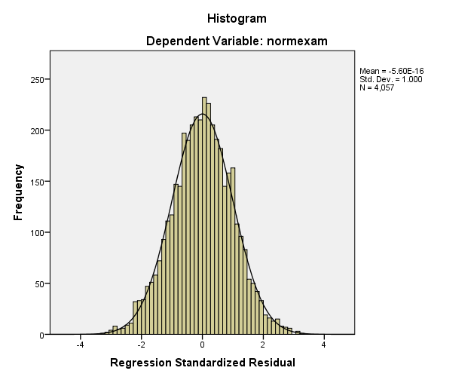
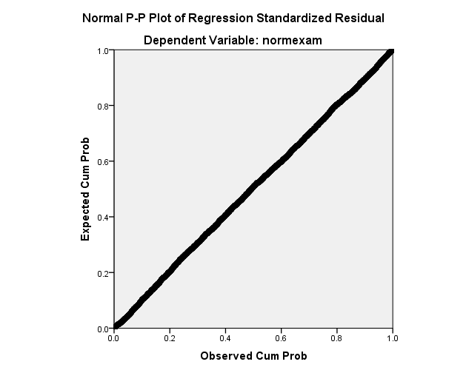
How to conduct and report MLR
Random Normal Distribution of Errors
Report as:
“The histogram of standardised residuals indicated that the data contained normally distributed errors, as did the normal P-P plot of standardised residuals, which showed all points were extremely close to the line”

Slide 66
How to conduct and report MLR
Non zero variances
Check your descriptive statistics
Reporting this:
“The data also met the assumption of non-zero variances (Exam Age 16 Variance = .995; Standard Reading Test Score Variance = .987 Gender= .240, Interaction Effect Standard Reading Score * gender = .542)”

Slide 67
How to report MLR
Regression results are often best presented in a table.
There is no standard approach – follow that for your domain.
You should at least present the unstandardized or standardized slope (beta), whichever is more interpretable given the data, along with the t-test and the corresponding significance level.
Tables are useful if you find that a paragraph has almost as many numbers as words.
If you do use a table, do not also report the same information in the text. It's either one or the other.

Slide 68
How to report MLR – Example (CA Example)
A multiple regression analysis was conducted to determine if a student’s score for well-being, mature student status and the type of educational institute being attended could predict a student’s academic satisfaction.
In order to include the type of educational institute being attended in the regression model it was recorded into two variables iot_dummy (0 for university or college, 1 for IoT), and college_dummy (0 for university or IoT, 1 for college).
Examination of the histogram, normal P-P plot of standardised residuals and the scatterplot of the dependent variable, academic satisfaction, and standardised residuals showed that the some outliers existed. However, examination of the standardised residuals showed that none could be considered to have undue influence (95% within limits of -1.96 to plus 1.96 and none with Cook’s distance >1 as outlined in Field (2013).
Examination for multicollinearity showed that the tolerance and variance influence factor measures were within acceptable levels (tolerance >0.4, VIF <2.5 ) as outlined in Tarling (2008). The scatterplot of standardised residuals showed that the data met the assumptions of homogeneity of variance and linearity. The data also meets the assumption of non-zero variances of the predictors.

Slide 69
Example Julie Pallant Survey.dat

Slide 70
Partial Correlations
Measures the relationship between two variables, controlling for the effect that a third variable has on them both.
Usually a variable you suspect is influencing your two variables of interest
This can artificially inflate the correlation co-efficient found

Slide 71
Partial Correlation
Using survey.sav/survey.dat
Julie Pallant
Interested in exploring the relationship between scores on the Perceived Control of Internal States Scale (tpcoiss) and scores on the Perceived Stress Scale (tpstress) but controlling for what is known as socially desirable responding bias (tendency to present yourself in a socially desirable way)
This tendency is measured using Marlowe-Crowne Social Desirability Scale (tmarlow)

Slide 72
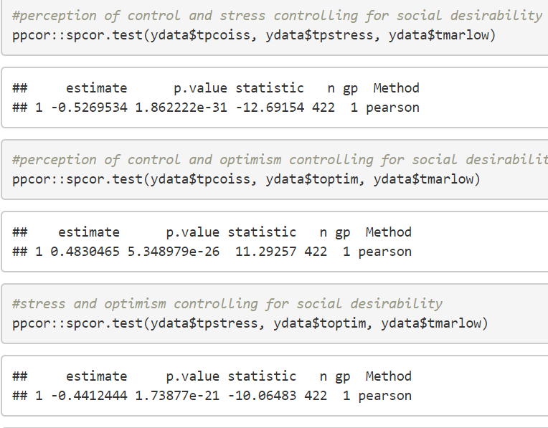
Patrial Corrleation

Slide 73
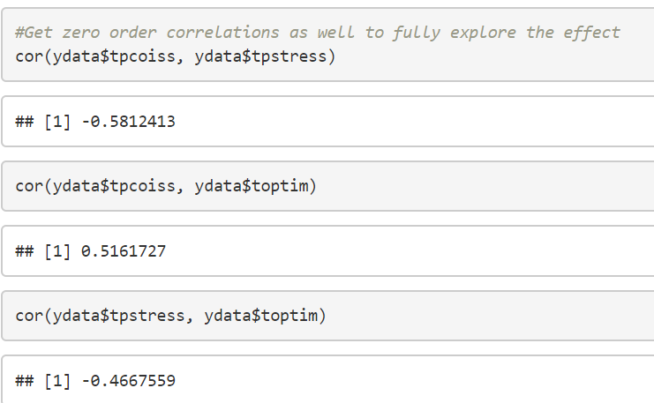
Zero order correlations

Slide 74
Reporting Results
Partial correlation was used to explore the relationship between perceived control of internal states (as measured by PCOISS) and perceived stress (measured by the Perceived Stress Scale), while controlling for scores on the Marlowe-Crowne Social Desirability Scale. Preliminary analyses were performed to ensure no violation of the assumption of normality, linearity and homoscedasticity. There was a strong, negative partial correlation between perceived control of internal states and perceived stress, controlling for social desirability, (r=-.53, n=422,p<.001). An inspection of the zero-order correlation (r=-.58) suggested that controlling for social desirability had very little effect on the strength of the relationship between these two variables.

Slide 75
MLR example
Is included in the RMD file accompanying the lecture.

